Slide 1

Docker

Slide 2
Setup a Docker ID
Required to download Docker Desktop Installer
Enables Use of Docker Hub to store and download Container Images
Not needed for Linux
hub.docker.com

Slide 3
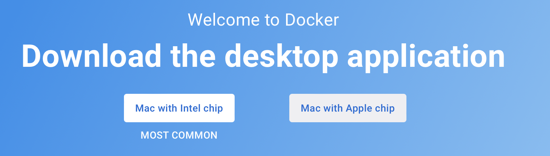
Now lets Install

Slide 4
Notes about Windows
At min Windows 10
4+ GB Ram
BIOS Level Hardware Virtualization
Docker Desktop Installer Enables Hyper-V and restarts Windows if Hyper-V is not enabled.

Slide 5
Run the Docker Commands
Verify Docker works
Open Powershell and run as admin
Run = “docker version”
Windows – Go to settings
Click on Shared Drives and click the checkmark and click apply

Slide 6
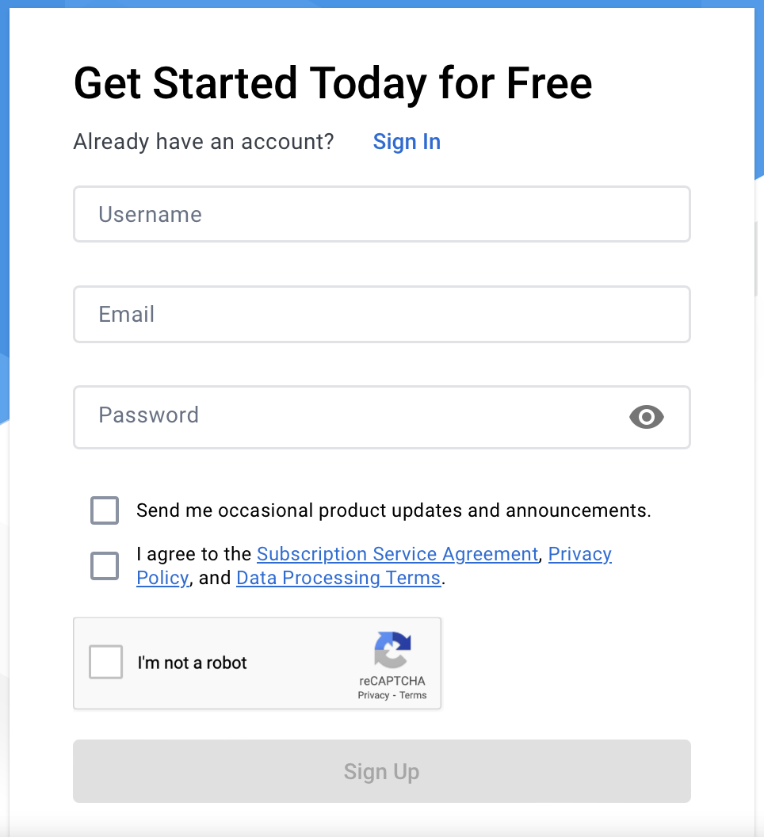
hub.Docker.com - Sign up - Fill out your profile - Confirm Email address

Slide 7
Notes About Windows
Must be MacOS 10.12
4+ GB of ram

Slide 8
Run the Docker Commands
First Login
Open Termanal
Docker version

Slide 9
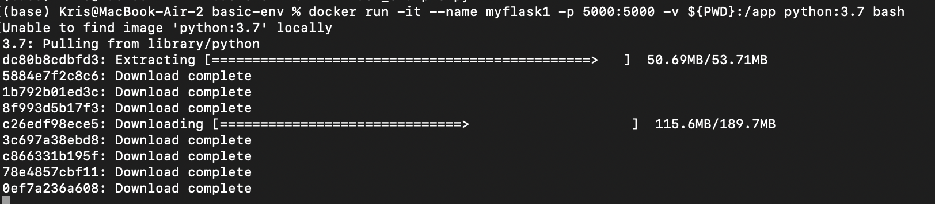

Slide 10
Hello World - Flask
from flask import
Flask app = Flask(__name__)
@app.route("/")
def hello() -> str:
return "Hello World”
if __name__ == "__main__":
app.run(debug=False)

Slide 11
Run a Docker Container
docker run -it --name myflask1 -p 5000:5000 -v ${PWD}:/app python:3.7 bash
When using Docker toolbox for Windows Home:
docker run -it --name myflask1 -p 192.168.1.15:5000:5000 -v ${PWD}:/app python:3.7 bash
root@#######:/#

Slide 12
Install Flask
From the terminal run pip install flask==2.2.3

Slide 13
Change directory and print the python
cd /app
cat flask_example.py
export FLASK_APP=flask_example.py
export FLASK_DEBUG=1
flask run --host=0.0.0.0
Now open localhost:5000

Slide 14
Lets create another Django container Container
In a new terminal Run:
docker run -it --name mydjango1 -p 8001:8000 -v ${PWD}:/app python:3.8 bash
In the container Run
pip install Django
django-admin startproject testsite
cd testsite
now run the test server:
python manage.py runserver 0:8000
Locahost:8001

Slide 15
Lets make a better test web page
In the app folder on the host
Create a file called views.py:
from django.http import HttpResponse
def index(request):
return HttpResponse("Hello World! I run in a Python Runtime Container! ")
Create a file called urls.py:
from django.urls import path include
from . import views
urlpatterns = [
path('', views.index, name='index’),
]

Slide 16
In testsite/urls.py
Change the following lines:
from django.urls import path, include
path('', include('app1.urls')),

Slide 17
Now let’s migrate the changes
python manage.py migrate
python manage.py runserver 0:8000
exit
docker run -it --name mydjango-beta -p 8000:8000 -v ${PWD}:/app python:3.8 bash

Slide 18
Lets create an updated server
docker run -it --name mydjango-beta -p 8000:8000 -v ${PWD}:/app python:3.8 bash
pip install django==3.0b1
cd /app/testsite
python manage.py runserver 0:8001
exit
docker start -ia mydjango1
cd /app/testsite
python manage.py runserver 0:8000
exit

Slide 19
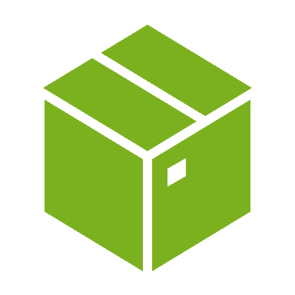
Now lets remove the containers
docker images
docker container ls -a
docker rm mydjango-beta

Slide 20
Remember when we would not install tenser. Yea lets do that again
docker run -it --name tf1 -p 8888:8888 -v ${PWD}:/tf/notebooks tensorflow/tensorflow:latest-py3-notebook
docker start -ia tf1
Note the URL and use the token
Note: Windows – Docker toolbox use docker-machine ip default
Ensure to close all notebooks

Slide 21
Train the sample model
Run all the cells in the notebook and notice the output and the wrong perdictions.

Slide 22
Lets look at the logs ( NEW)
Run all the cells in the notebook and notice the output and the wrong predictions.
docker run -it --rm -p 6006:6006 -v ${PWD}/logs:/tf/logs tesorflow/tensorflow tensorboard --bind_all --logdir /tf/logs

Slide 23
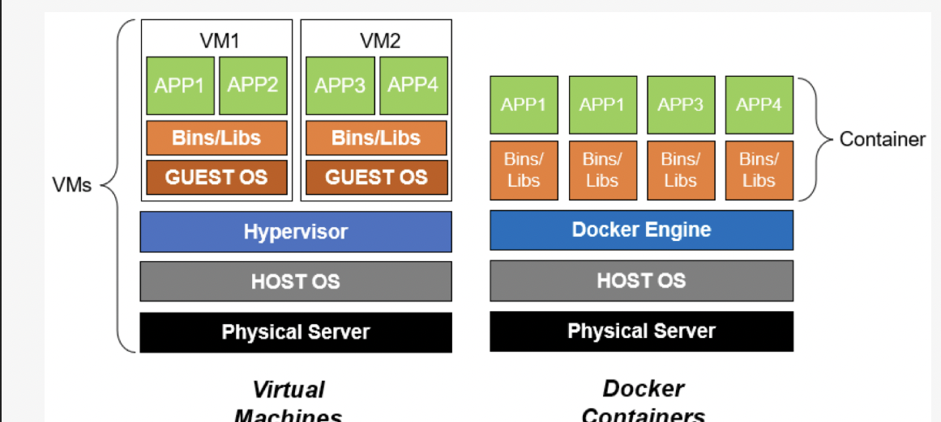
Recap what is a container

Slide 24
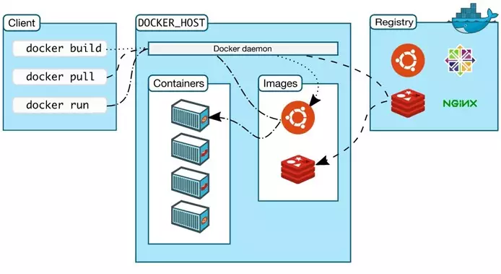
How do containers communicate

Slide 25
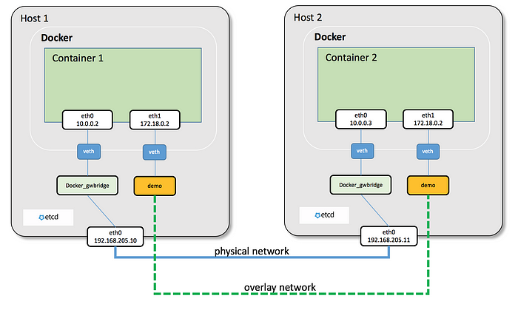
How do containers communicate - Con
Overlay Networking:
A container is given 2 IP addresses.
Overlay Network for communicating to other containers
VXLAN (Virtual Extensible LAN) is a tunnel to other networks.

Slide 26
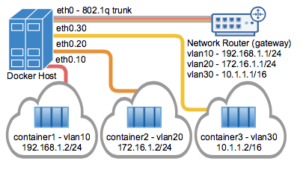
How do containers communicate - Con
MAC/VLAN Driver:
A hardware way of networking Containers are given a virtual hardware or MAC address under a Virtual LAN (VLAN).
Each containers will need a full TCP/IP stack therefor like a physical device.
Note: MAC/VLAN carries overhead

Slide 27
How do containers store Data
A container image has all of the applications already installed on the container file system and are downloaded and saved to the containers file system.
We can have an application store information in the file systems.
Data management is limited within the container to save the information and create a snapshot or use a container manager.
Container filesystems are destroyed when a container is closed.
Data does not persist from one container to another so how do we save the data?
We need to mount the host drive to the container
Notes:
Draw an image of the file structure

Slide 28
Bind Mount
docker run -it --name mypython1 -p 5000:5000 -p 8000:8000 -v ${PWD}:/app python:3.7 bash
Containers can only access the bind mounted files
Applications can create sub folders within the host
Container data is stored on the mount directory and will percist after containter shutdown.
Not ideal in a production process due to the high probability of a container being started on another cluster.

Slide 29
Volume Mounted
Like a host mounted (bound) file system the container will use a Docker Volume Storage
Think Kubernetes or AWS volumes (drives) that are outside the host that a container
Also
The Volume will persist and can be mounted later.
To have the files on the host system Data needs to be move from the Volume storage and then using a bound drive it can be moved to the host system.

Slide 30
Application Design Patterns
Docker is not good for high GPU intensive tasks
It is good for Text or parallel running applications
Interactive, Text-based
Jupyter Server for Research and Experimental
Single Container Web-Based Application
Development Runtime and Test Environment

Slide 31
Build your own images - Why
We make an image to Simplify and Shorten Deployment
Create self-contained, ready to run Container Templates
Sets Customized Start-up Commands or Scripts
Standardizes and ensures consistent start points for your applications.
Increases agility

Slide 32
Build your own images – What
Prepare Image Filesystem:
Base image
Installed Required Systems Packages
Install Libraries
Copy Source, Configuration and Data Files
Execute Initialization Commands
Define Metadata:
Working Directory
Environment Variables
Setup-up Commands
Establish Mountpoints
and so on

Slide 33
Build your own images – How
Manual Image Creation – docker commit
Docker Build – docker build ( easiest )
Tools:
Buildah
Orca
Kaniko
GitHub/Docker Hub/GitLab Etc

Slide 34
Web Framework

Slide 35
What is a Web Framework?
Web framework is a set of components designed to simplify your web development process.
It has basic structuring tools in it, which serve as a solid base for your project.
It allows you to focus on the most important details and project’s goals instead of creating things, that you can simply pull out of the framework.

Slide 36
What is a microframework
A microframework is a framework that does not require any particular tools or libraries. It has no databases .

Slide 37
Django

Slide 38
What is Djanjo (Jango)?
Django is a Web Application Framework, written in Python
Allows rapid, secure and agile web development.
Write better web applications in less time & effort.
Django is loaded with security features that are used by default.
Security by default provides great protection to developers with no security experience
Django makes it more difficult to write insecure code

Slide 39
Who uses Django
Django is used by:
Google
Instagram
Mozilla
Pintrest
Nasa
Library of congress
ETC

Slide 40
Security Features of Django
Django provides many default protections against web threats, mainly against problems of:
User Management
Authorization
Cookies
SQL Injection
Cross Site Scripting (XSS)
Cross Site Request Forgery (CSRF)
Clickjacking
Files
E-mail Header Injection
Cryptography
Directory Traversal

Slide 41
User Management
Django provides a default User model that can be used in any website. It comes equipped with correct session management, permissions, registration and login.
Developers don’t need to re-invent the wheel and re-introduce user management risks.
Django provides strong password hashing methods (bcrypt, PBKDF2, SHA1), with increasing work factors.
Django provides easy methods for user management such as is_authenticated(), permission_required(), requires_login(), and more, offsetting difficult session and permission code away from the developer.
Django provides secure default password reset and login redirection functionality. Developers don’t need to create password reset forms and introduce risks.

Slide 42
Databases?
Django supports:
PostgreSQL
SQLight
MariaDB
MySQL
Oracal

Slide 43
Flask

Slide 44
Flask - What is it
Flask is a micro web framework written in python
Open Source and Free
Flask does support extensions that can add application features
Easy to code (python)
Easy to configure
Wont make decisions for you (does not forces you to pick a database etc)

Slide 45
Why Flask vs Django
Unlike the Django framework, Flask is very Pythonic. It’s easy to get started with Flask, because it doesn’t have a huge learning curve.
On top of that it’s very explicit, which increases readability.
Django is complex but one of the best for developing sophisticated application

Slide 46
